Slide 1
A PROJECT REPORT on GREEN 4 YOU WEBSITE

Slide 2
ACKNOWLEDGEMENT
It is great happiness and privilege for me to represent this project report.I have completed the development of Green 4 you website.
I would like to express my gratitude towards all those people who have helped me in successful completion of my project.

Slide 3
INTRODUCTION
The growing significance of websites for various organizations is well known.In recognizing that we decided to develop a website for the Green 4 you.
Purpose of the project:
The purpose of the project is to design,publish and maintain a website for our Earth.which consists of all the information regarding the how to save our Earth.

Slide 4
Glossary:
TERM | DEFINITION
HTML | Hyper Text Markup Language
CSS | Cascading Style Sheets
JSC | JavaScript Certificate

Slide 5
REQUIREMENTS
Software Requirements:
Browser :Internet Explorer,Google Chrome.
Operating System :Any windows version/MAC
Client side Scripting :JavaScript
Hardware Requirement:
Ram :512 MB or more
Hard disk :40 GB or more
Monitor : hp 1022
Key board : 108 KEYS
Mouse :PS/2

Slide 6
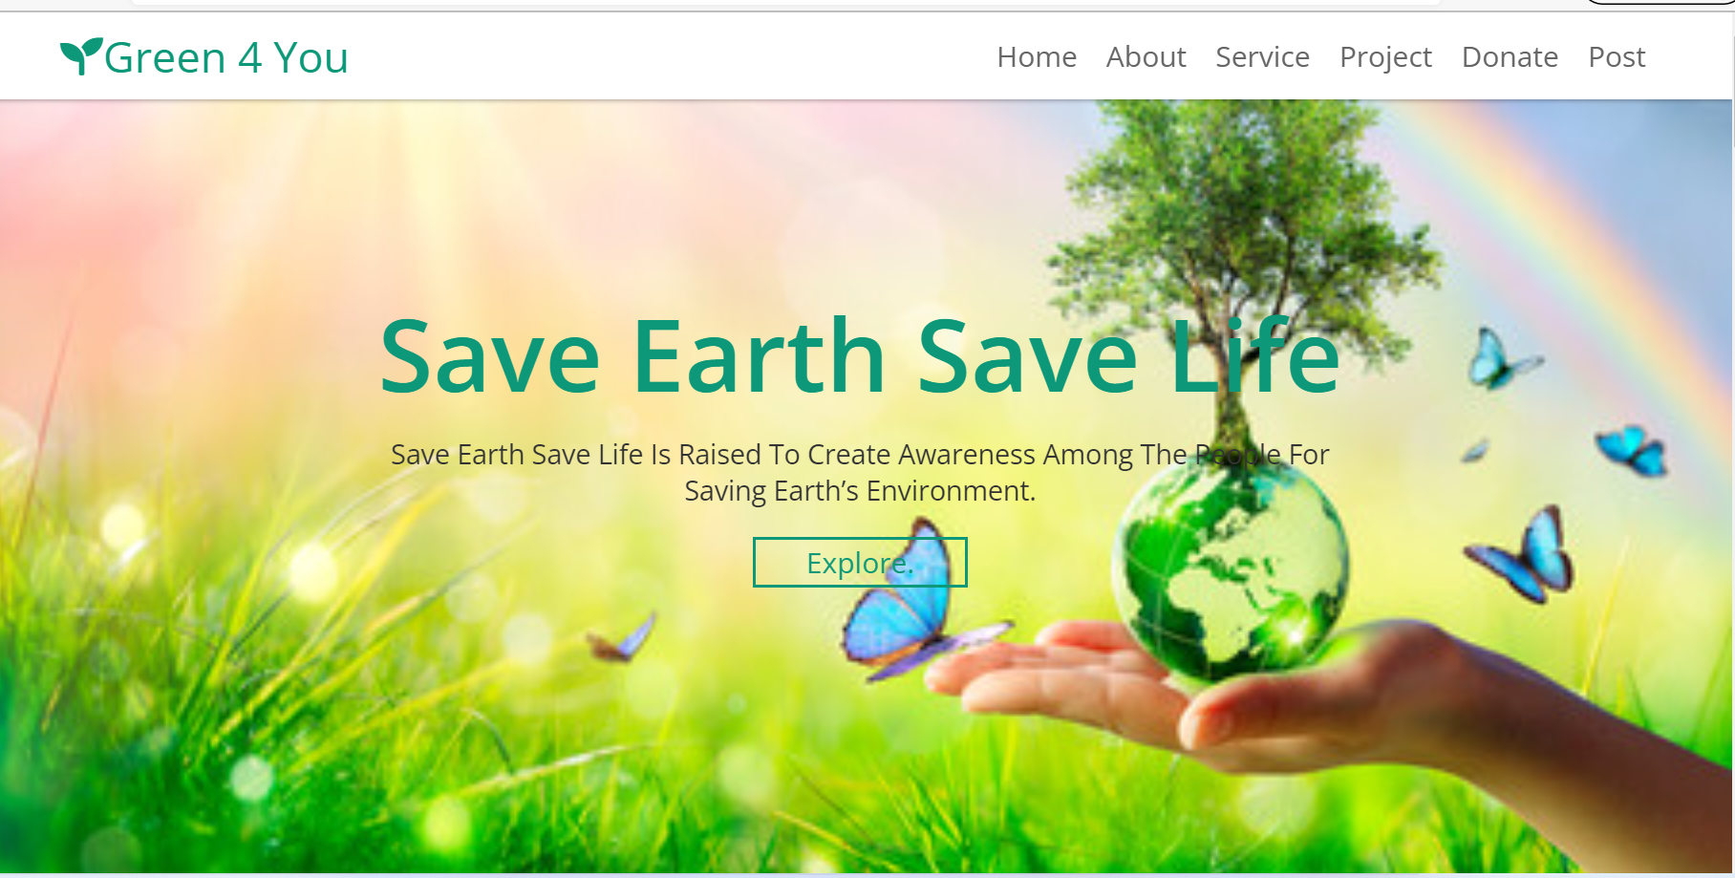
Green 4 you website

Slide 7
Home page
The home page of a website is the first page that a user perceives upon entering the website url at the browser address area.
The entire website depends on how the page is designed.In short,a home page forms the abstract of the entire website.

Slide 8
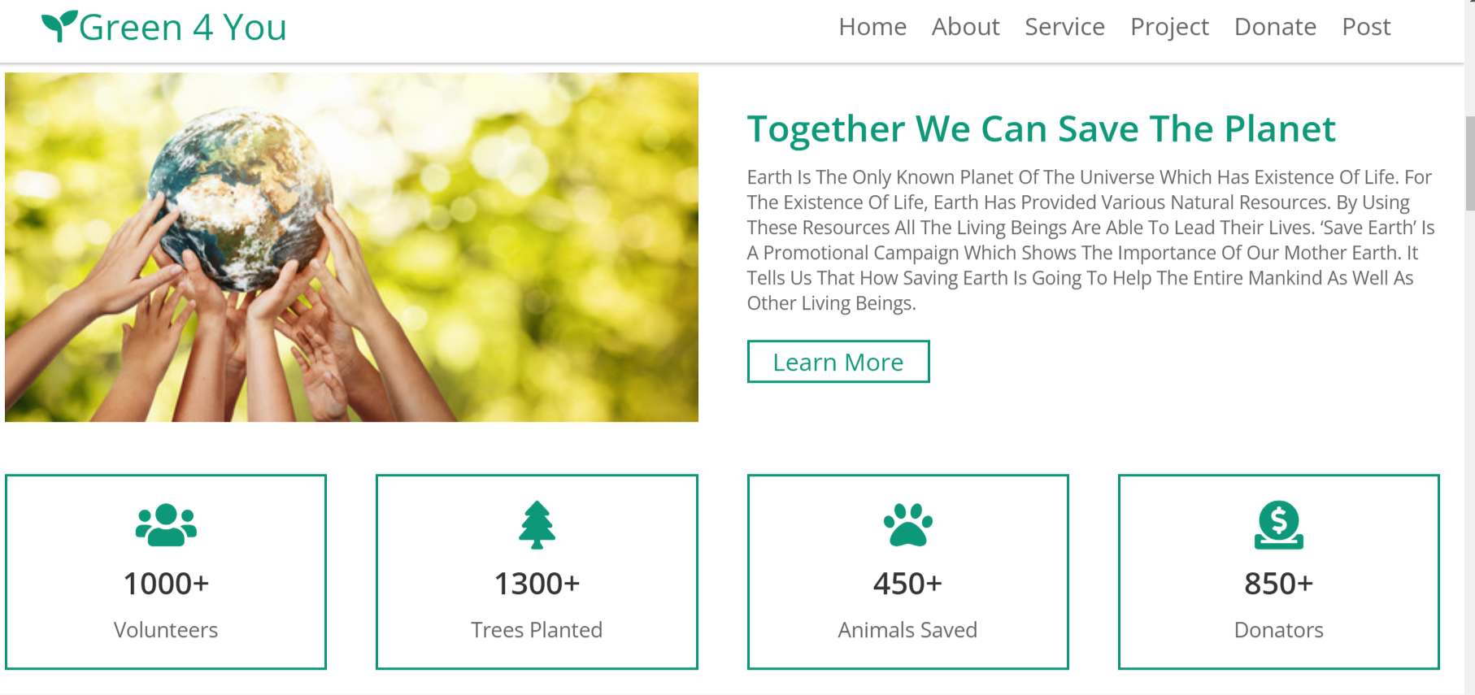
About page

Slide 9
*
The about page of a website is the second page.
IN these page tells there are 1000+ volunteers, planted 1300+ trees,saved the 450 animals and they have 350+ donaters .

Slide 10
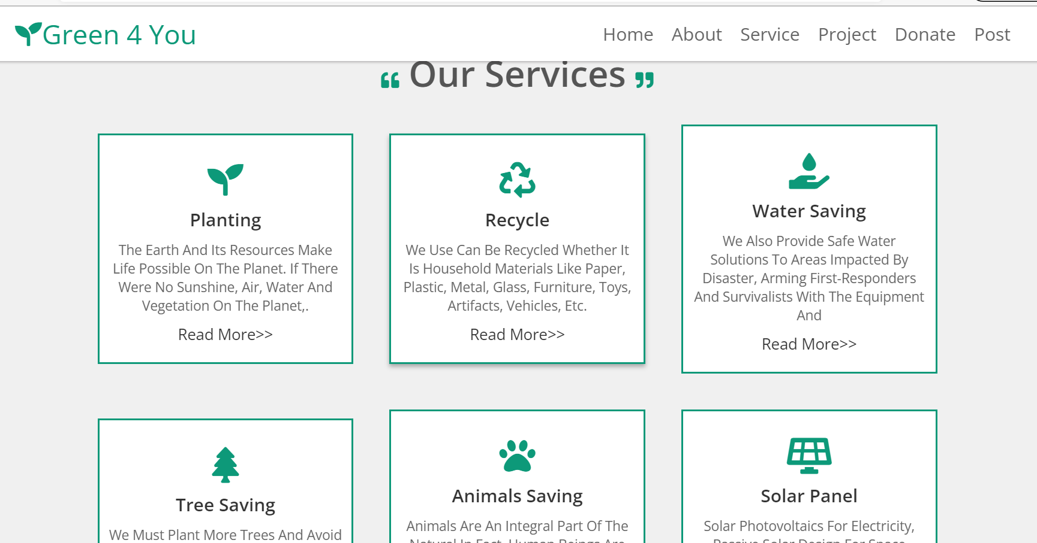
Service Page

Slide 11
*
This service page is the third page of the website.
These page tells about their services like planting,recycling,water savings,solar panel,tree saving and animal saving.

Slide 12
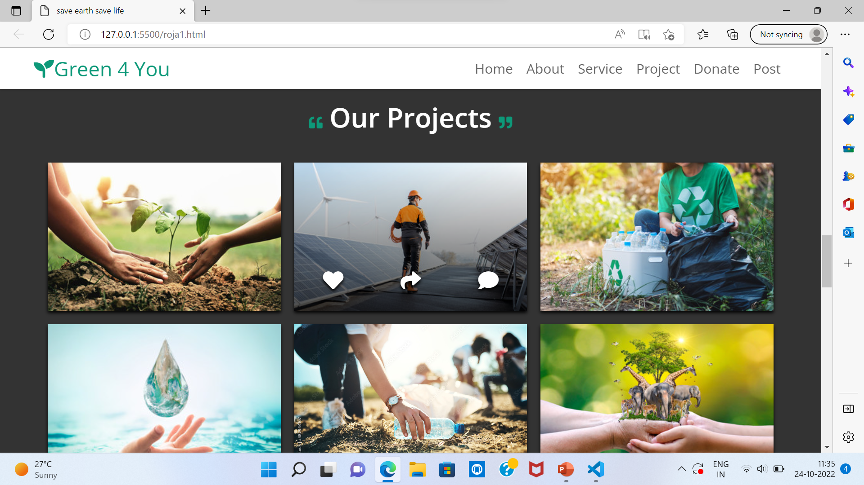
Project page

Slide 13
*
These page shows their projects on save earth save life.
They can save earth by saving trees,natural vegetation,water,naturalresources,electricity,etc.

Slide 14
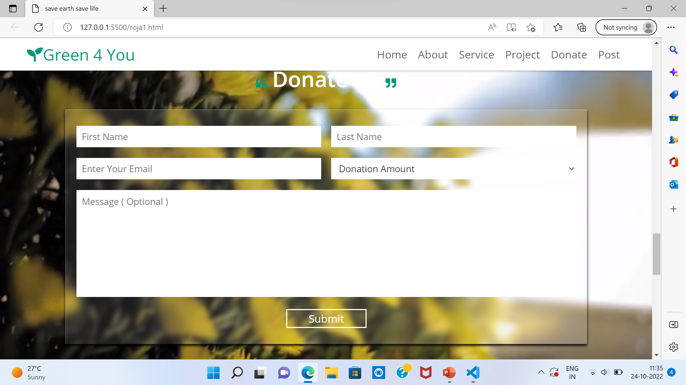
Donate page

Slide 15
*
This form is about the donation of money for Green 4 you website.
Donators can enter their firstName , LastName , email Id and donation Amount.
After completion of the form then we click the submit button and submit to the green 4 you website.

Slide 16
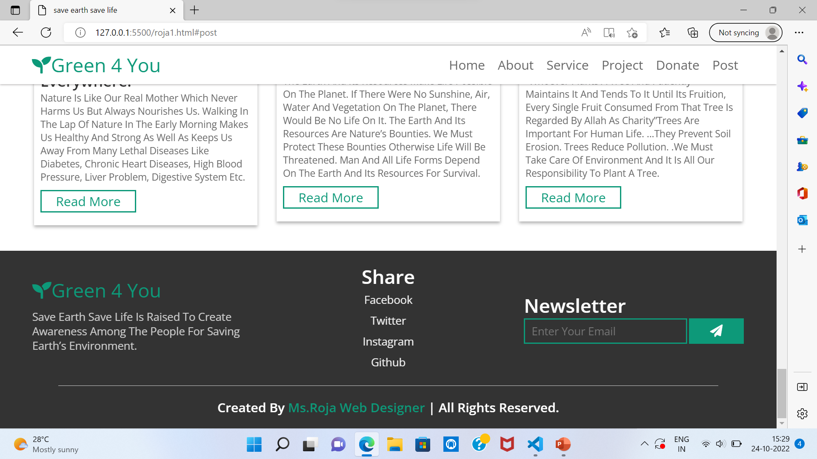
Footer page

Slide 17
*
This footer section is the bottom of webpage.It typically contains a copyright notice,link to a privacy policy,logo,contact information,social media icons and email sign-up form.
The purpose of footings is to support the foundation and prevent setting.

Slide 18
Conclusion
The goal of our project is raised to create awareness among the people for saving earth’s environment.
Saving our earth and its environment becomes highly important as it provide us food and water to sustain life.
Our well-being solely depends on the planet it gives food and water to all living things to it is our responsibility to take care of it.

Slide 19
THANK YOU

